Slide 1


Page de garde

Slide 2



Who I am ?
Frédéric Chhean
Background
Why Ironhack ?

Slide 3
Problem identified & Oppotunity
LACK OF KNOWLEDGED ABOUT FUNNY THINGS / LACK OF SOCIAL GAME

Slide 4

THE GAME: SECRET FACTS

Slide 5
Technical Challenges
HTML
CSS
Javascript
DOM tree
Selectors
Functions
Block vs Inline
Style
Array
Tag
Positioning
Objects
..... So much things
..... So much things
..... So much things

Slide 6

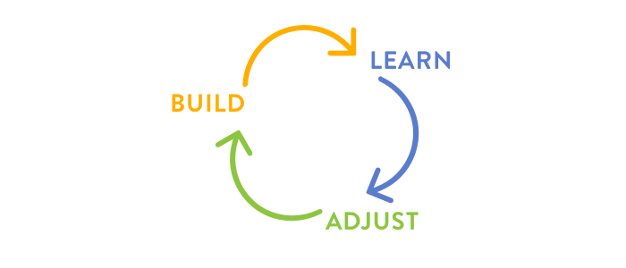
Technical Challenges
How to make my mind well with all the concepts and mix everythins ?

Slide 7

Biggest Mistakes
NOT think of a global overview and all the user journey before acting

Slide 8
Product Road Map
Working with UX / UI Designer and XP Developers for updated version
International deployment
2019
2020
S2
S3
S4
S1
MVP
Presentation and sell it
to Facebook

